Slide 1
Primary Level
VISUAL ROUND

Slide 2

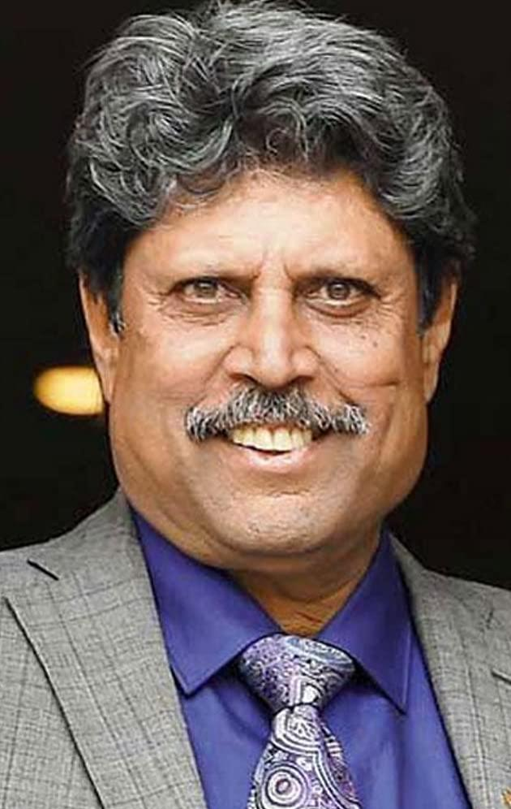
Identify this personality

Slide 3
KAPIL DEV
Kapil Dev Ramlal Nikhanj is an Indian former cricketer. He was a fast medium bowler and a hard hitting middle order batsman. He led India to win its first Cricket World Cup title in 1983. He was named by Wisden as the Indian Cricketer of the Century in 2002

Slide 4
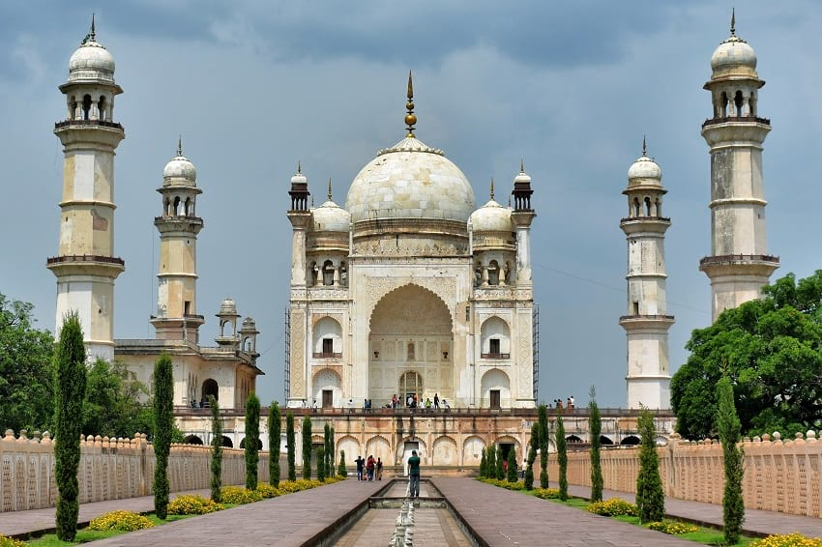
Identify this monument

Slide 5
BIBI KA MAQBARA
The Bibi Ka Maqbara is a tomb located in Aurangabad, Maharashtra, India. It was commissioned in 1660 by the Mughal emperor Aurangzeb in the memory of his wife Dilras Banu Begum (posthumously known as Rabia-ud-Daurani) and is considered to be a symbol of Aurangzeb's 'conjugal fidelity'.It bears a striking resemblance to the Taj Mahal, the mausoleum of Aurangzeb's mother, Mumtaz Mahal.

Slide 6

Identify this flag

Slide 7
SOUTH AFRICA’S FLAG
The flag of South Africa was designed in March 1994 and adopted on 27 April 1994, at the beginning of South Africa's 1994 general election, to replace the flag that had been used since 1928.

Slide 8

Identify the Logo

Slide 9
MERCEDES-BENZ
Mercedes-Benz, commonly referred to as just Mercedes, is a German luxury automotive marque. Mercedes-Benz and subsidiary Mercedes-Benz AG – of Daimler AG – are headquartered in Stuttgart, Baden-Württemberg, Germany. Mercedes-Benz produces consumer luxury vehicles and commercial vehicles.

Slide 10
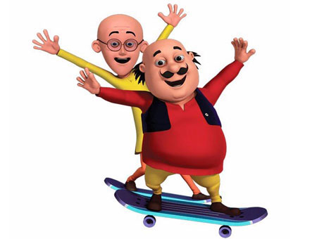
Identify this cartoon .

Slide 11
MOTU AND PATLU
Motu and Patlu are stars of Lot Pot Comics and they have been a favourite among children for more than four decades. Motu is fat and friendly and is very fond of samosas and his friend Patlu, even though he cannot read, carries a newspaper with him. They are simple and often clueless how to handle situations but they manage to cope with the difficult situation somehow with the help of their friends. One statement is always highlighted in the series “Bure Kaam Ka Bura Natija”. So, in fun way some Indian values are also learnt by children while watching this animated series. Children enjoy this lot.
Not only Motu and Patlu but also other cartoon characters in this series are popular amongst children. These characters include Dr. Jhatka , Ghasitram, Inspector Chingum, John, Number 1 and Number 2, Boxer etc. Overall it is fun and entertaining series for not only children but also adults.

Slide 12
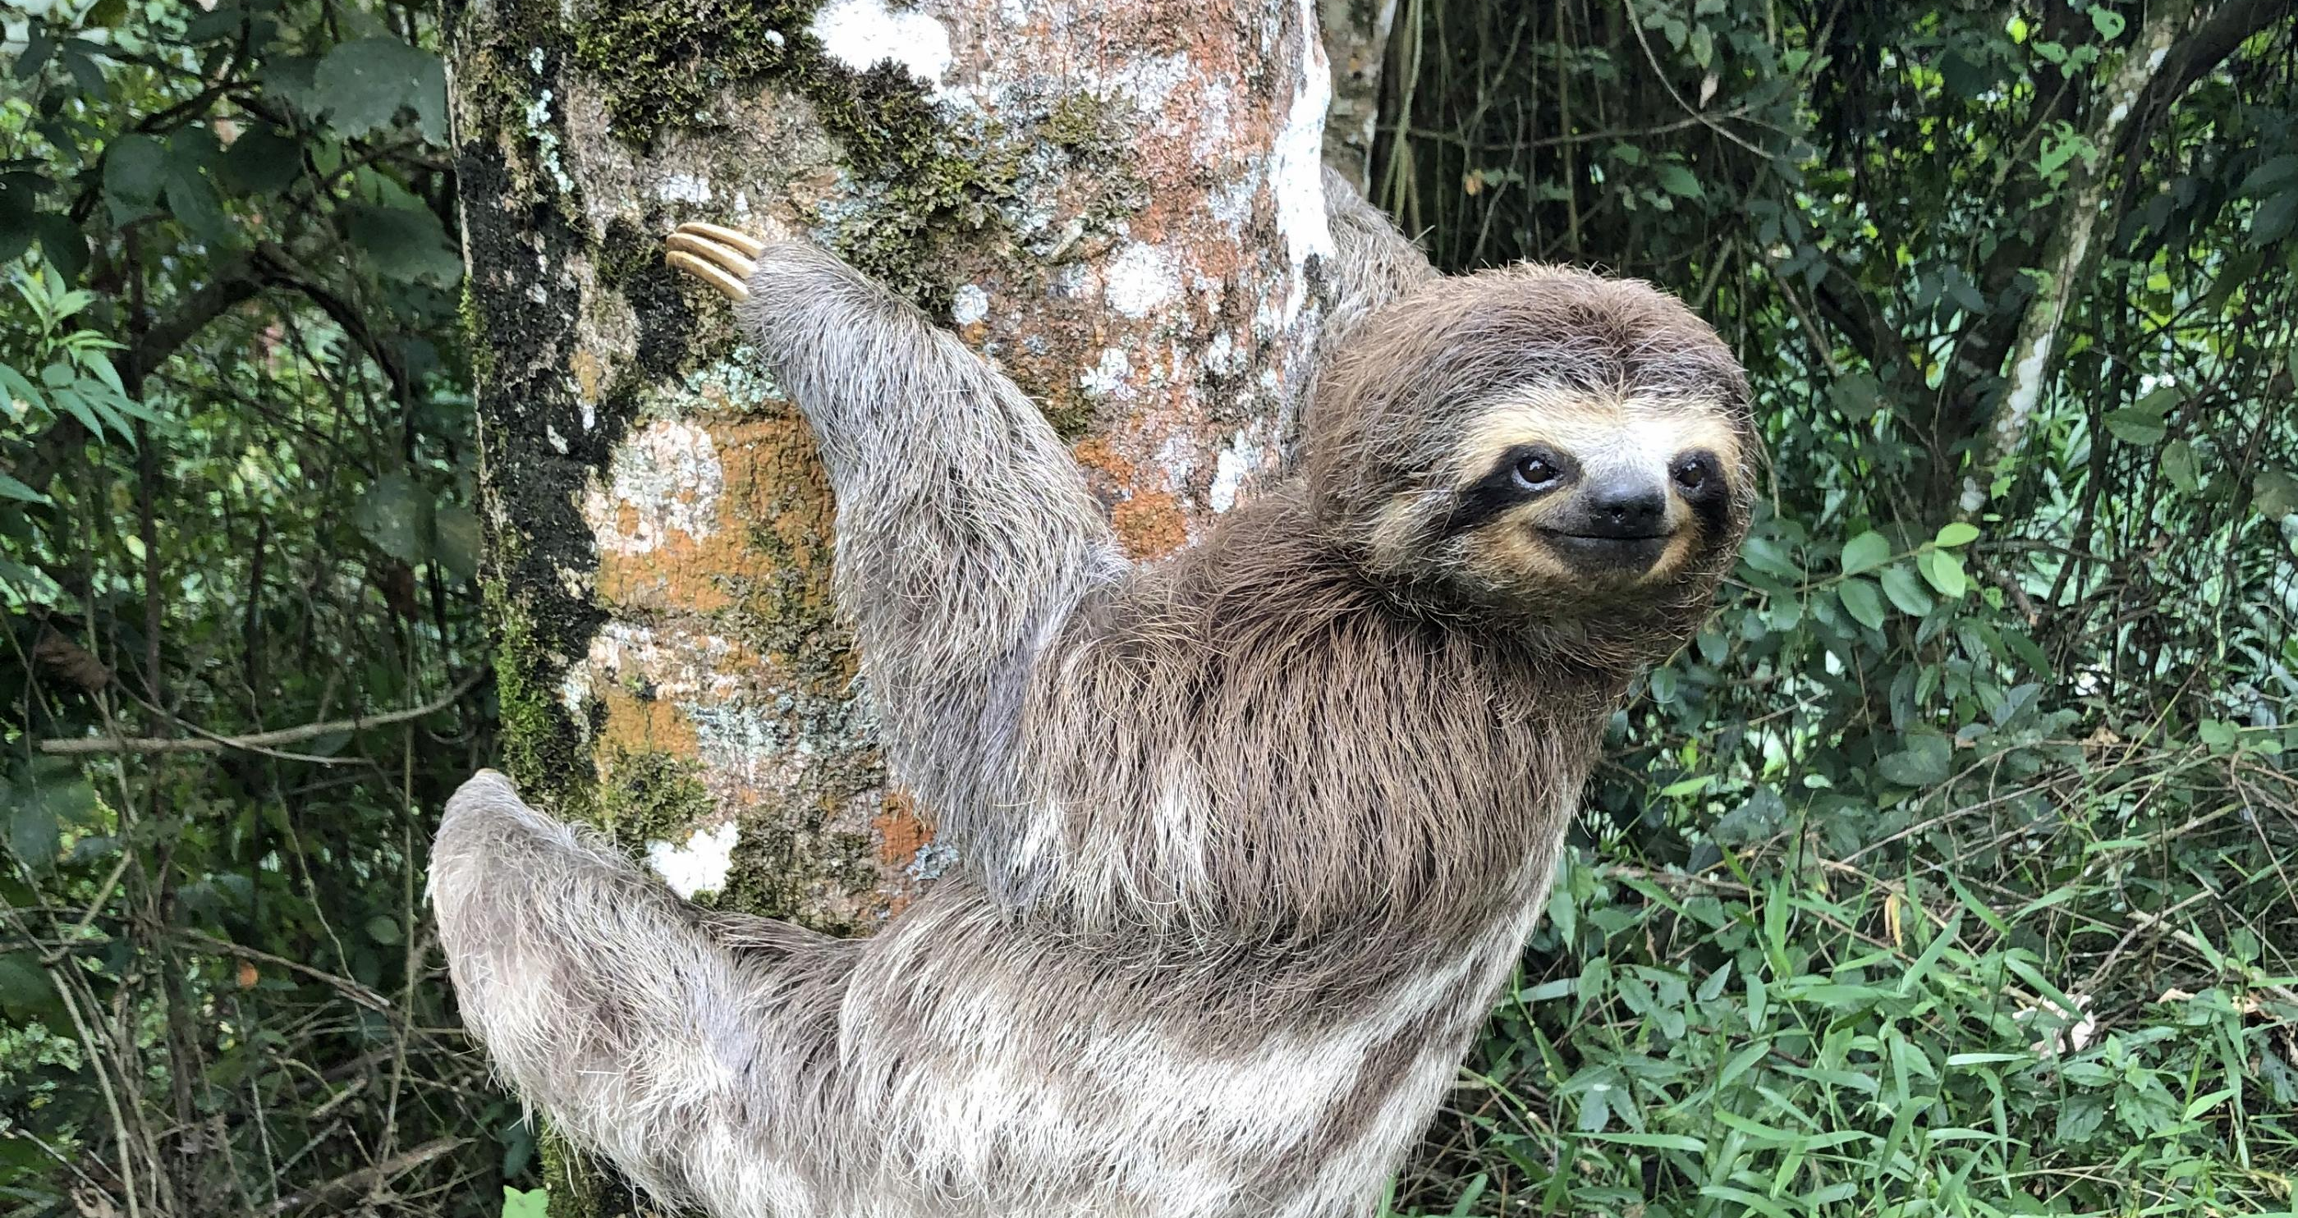
Identify this animal

Slide 13
SLOTH
Sloths are a group of arboreal Neotropical xenarthran mammals, constituting the suborder Folivora. Noted for their slowness of movement, they spend most of their lives hanging upside down in the trees of the tropical rainforests of South America and Central America.

Slide 14

Identify the sport

Slide 15
GOLF
Golf is a club-and-ball sport in which players use various clubs to hit balls into a series of holes on a course in as few strokes as possible.

Slide 16
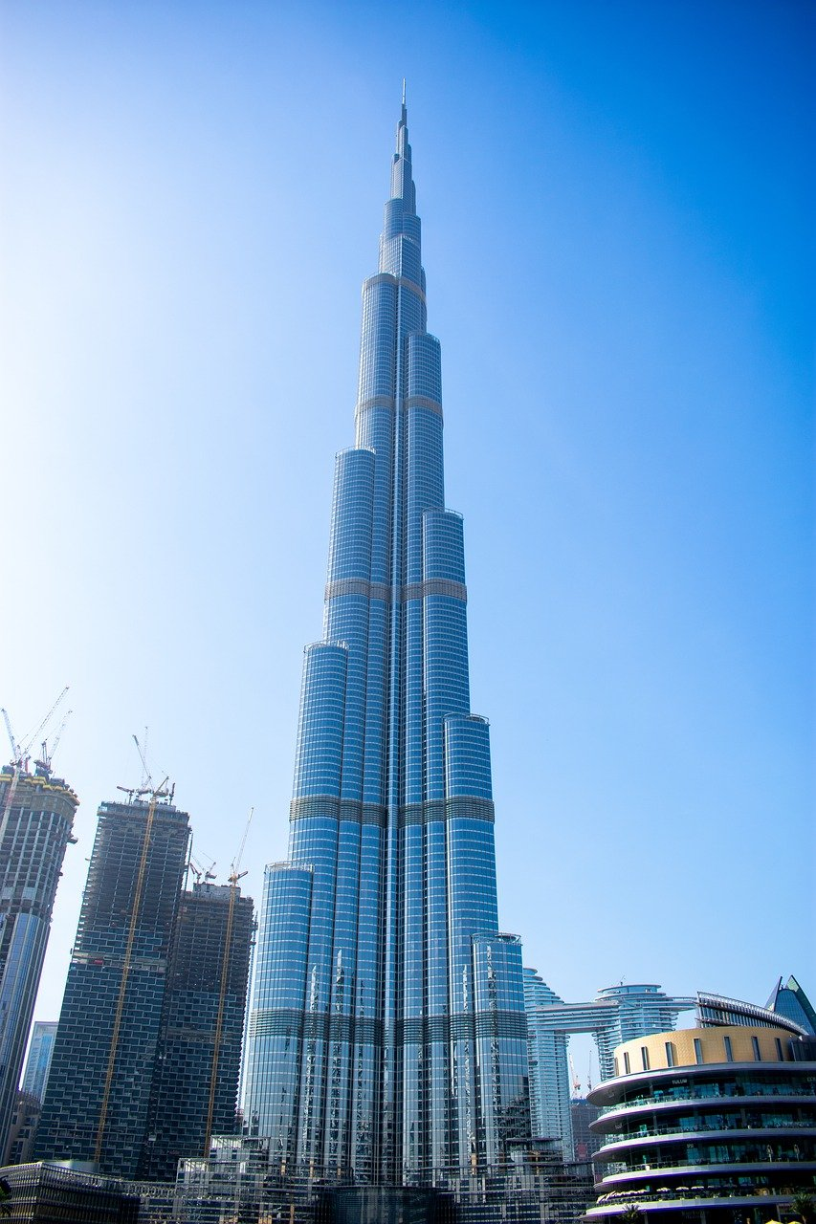
Identify this building

Slide 17
BURJ KHALIFA
The Burj Khalifa,known as the Burj Dubai prior to its inauguration in 2010, is a skyscraper in Dubai, United Arab Emirates. With a total height of 829.8 m (2,722 ft), just over half a mile and a roof height (excluding antenna, but including a 244 m spire) of 828 m (2,717 ft), the Burj Khalifa has been the tallest structure and building in the world since its topping out in 2009, supplanting Taipei 101, the previous holder of that status.

Slide 18
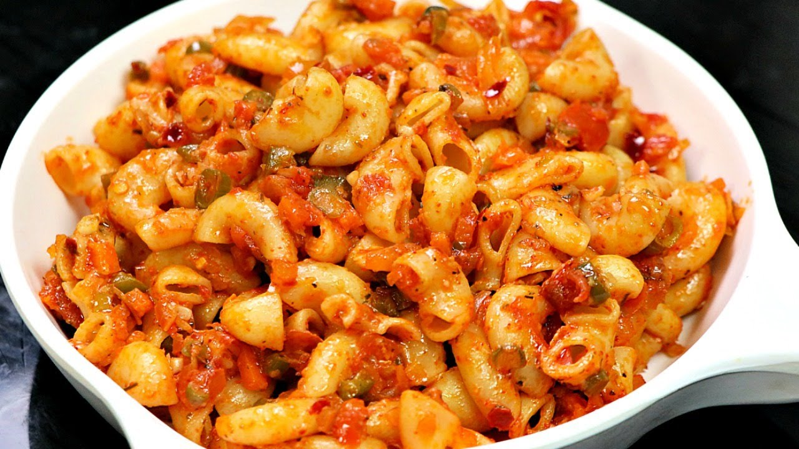
Identify the dish

Slide 19
PASTA
Pasta is a type of food typically made from an unleavened dough of wheat flour mixed with water or eggs, and formed into sheets or other shapes, then cooked by boiling or baking.

Slide 20
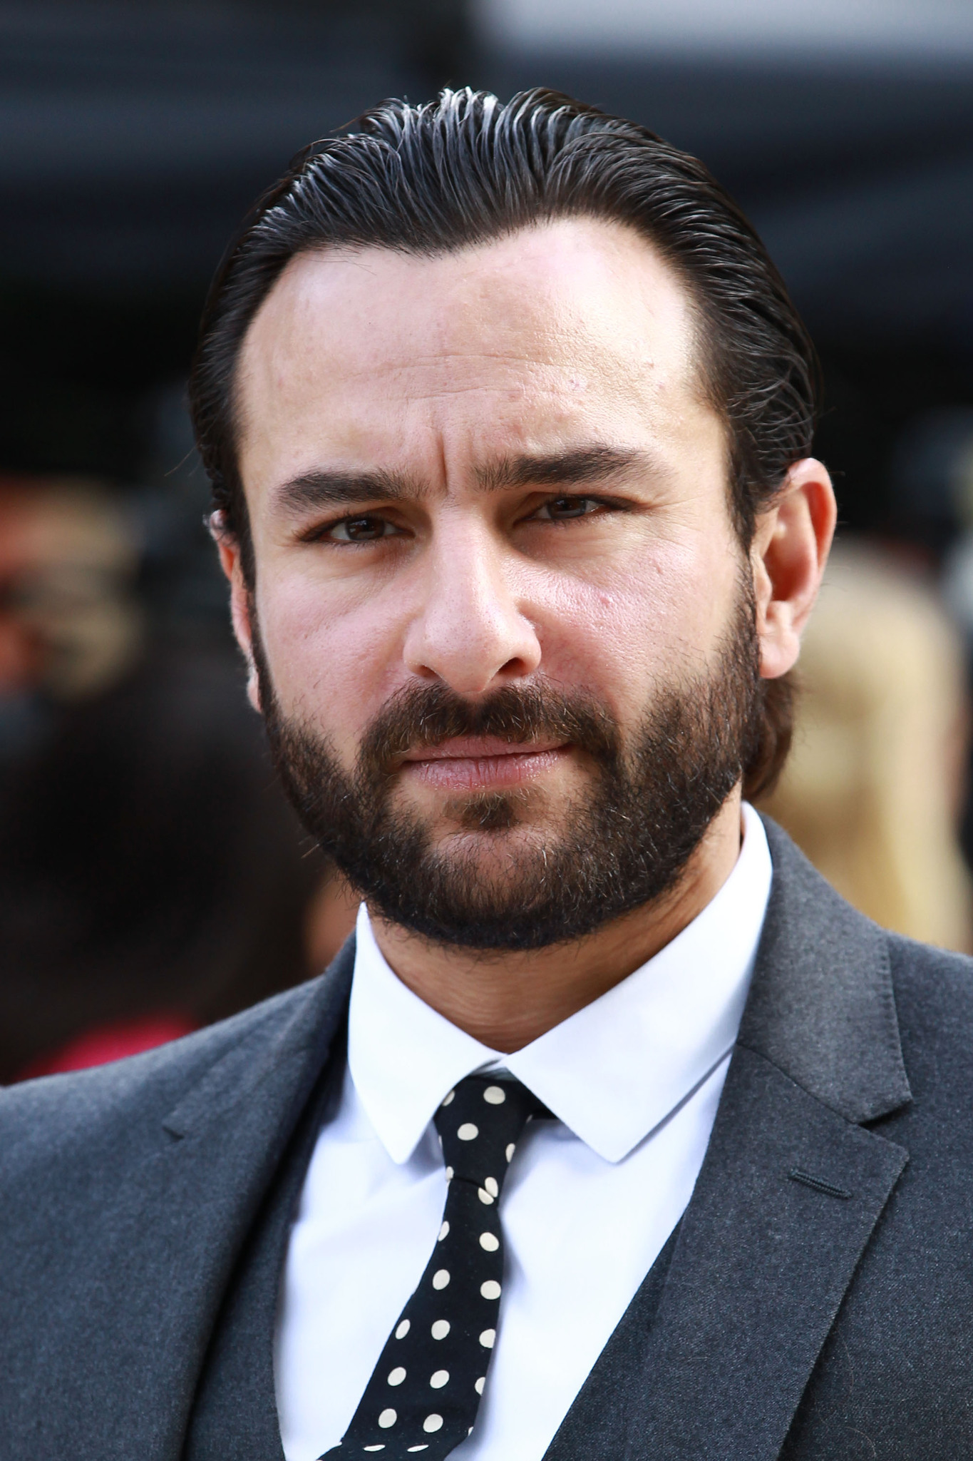
Identify this personality

Slide 21
SAIF ALI KHAN
Saif Ali Khan is an Indian actor and producer who works in Hindi films. The son of actress Sharmila Tagore and cricketer Mansoor Ali Khan, Khan made his acting debut in Yash Chopra's drama Parampara, but achieved success with his roles in the romantic drama Yeh Dillagi and the action film Main Khiladi Tu Anari

Slide 22
Thank you

