Slide 1
Phases Of Teaching
Mr.K.K.Biswal
Associate Professor
Harkamaya College Education
24/07/2019

Slide 2
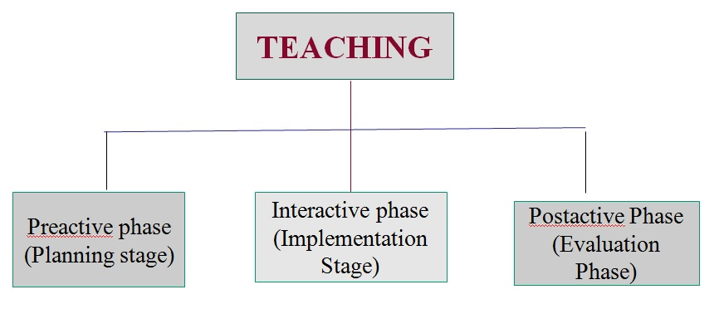
Phases Of Teaching
Different steps constituting the teaching process are called the phases or stages of Teaching.
Philip W. Jackson divides the teaching act into three phases
Pre-active phases of teaching
Interactive phases of teaching
Post active phases of Teaching

Slide 3
